Slide 1
University 101
Ryan Sullivan Associate Vice-President Enrolment St. Thomas University
avp.enrolment@stu.ca
@RyanSullivanNB
RyanSullivanSTU
@ryansullivannb

Slide 2
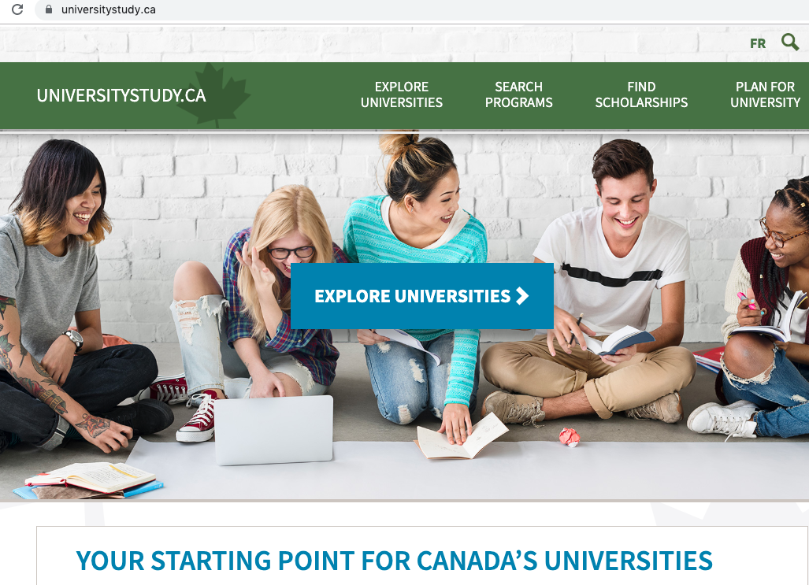
universitystudy.ca

Slide 3
Investing in your future

Slide 4
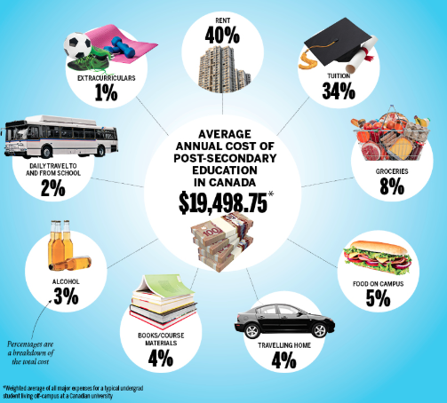

Slide 5
Value of a University degree

Slide 6
Common undergraduate degrees:
Arts - B.A. History, English, Gender Studies, Languages, Political Science, Philosophy
Commerce or Business Administration - B.Comm. or B.B.A. Finance, Accounting, Marketing, Management, Entrepreneurship, Humans Resources, Economics
Computer Science - B.C.Sc. Geographic Information, Software Development, E-Commerce, Software Engineering
Engineering - B.Eng. Chemical, Civil, Electrical, Environmental, Industrial
Fine Arts - B.F.A. Drawing, Painting, Photography, Printmaking, Sculpture, Textiles, Jewelry, Ceramics, Fashion, Art History, Art Education
Kinesiology - B.Kin. Sports Psychology, Exercise Physiology, Health Promotion and Wellness
Music - B.M. Theory, Composition, Music History, Music Education, Performance
Nursing - B.N. Prepares graduates to write the National Licence Examination.
Science - B.Sc. Biology, Chemistry, Biochemistry, Environmental, Marine

Slide 7
Universities in Canada
Approximately 100 publicly funded universities in Canada
Various program offerings
Same quality of education
All about the right fit and what type of experience you are looking for.

Slide 8
Focus on what is the best fit. What will provide you with the best experience?
Location
Size of campus
Urban vs rural
Close to home vs far from home
Specialty programs
Athletics
Extra-curricular activities offered

Slide 9
Terminology
Undergraduate degree- four year program- Bachelor of Arts, Bachelor of Science, Bachelor of Business Administration, etc.
GPA – Is the way most Universities measure your success. For example, an A in a class will likely translate into somewhere around a 3.7 GPA
Major – A declared focus for your degree, indicating a specified number of courses at an advanced level
Viewbook- book of university information including admission requirements, program info, etc
Minor – Still focused, but at a lesser degree than a major
Credit Hours – A value assigned to courses and labs that indicate its academic weight. Degrees often require 120+ credit hours for completion and on average a course is 3 credit hours
Degree - A degree is a certificate offered by your university which is received after you have completed the requirements set out by your university in the calendar
Academic Calendar – Your “bible” to your University education

Slide 10
Calendar
September
Start exploring university websites and asking friends, parents, and teachers, etc about university options they are familiar with.
October
Attend an Open House and participate in Student for a Day; register at the institutions’ websites. Attend a university presentation or evening session hosted at your school or in your community
November Attend the post-secondary fair at SRHS!
Research post-secondary education institutions’ programs to learn more about fees, admissions requirements, qualifications earned, length of program, preparation for the work world, Co-op terms, residence, exchange opportunities, etc.
If your grade 11 average is good, you can apply for university early admission
December
Meet with recruiters and double check admissions requirements. If necessary, make course changes for second semester. Post- secondary education admission in Canada is based on marks earned in specific grade 12 courses. English 121/122 is always required for university.

Slide 11
Calendar
January
Apply to university with your final first semester (January exam) marks.
February
University Admissions Entrance Awards are based on 5 or 6 grade 12 academic courses. If English 122 is taken second semester, your English 111/112 mark will be used as a “predictor”.
March
Scholarship deadline! Start regularly applying for bursaries and scholarships;
April
See your Guidance Counsellor about applying for school based scholarships awarded at graduation. Pay deposit and make decisions about roommates and courses.
May
Student Loans are used by over 50% of students, online applications open in May: www.studentaid.gnb.ca Select your university classes.
June
You must inform your school office by early June if you receive scholarships and bursaries for recognition during graduation.
Remember to request the office send your final transcript to your selected institution.

Slide 12
Moving forward
Connect with the Admissions/Recruitment advisor responsible for your school
Ask questions!
Fill out contact information cards so that schools can contact you
Collect brochures and visit university websites
Go for a campus tour or attend an event

Slide 13
Questions to ask representatives:
What programs do you specialize in?
What are your entrance requirements?
What is the length of the program?
Do you offer Co-op, internship, study abroad, practicums, etc?
How much is tuition and other fees?
Are there resources available for supporting student learning?
What is the average size of first year class?
Are there scholarships? How do I qualify?
Are there student services available on campus (e.g. computer facilities, residence, athletic centre, library, cafeteria, counselling, medical services, etc.)

Slide 14
University 101
Ryan Sullivan Associate Vice-President Enrolment St. Thomas University
avp.enrolment@stu.ca 506.453.7213
@RyanSullivanNB
RyanSullivanSTU
@ryansullivannb

