Slide 1
Course Selection 2020 -2021

Slide 2
Fact
By 2011, more than ½ of the world population was under 25 years old.
We are the 1st generation of parents to raise our kids with the Internet.
Challenge
They don’t need us for information, but for interpretation. We must help them make sense of all they know. Our job isn’t to enable them to access data but to process data and form good decisions.
1st step – enable them to recognize their passions and strengths and use them to engage the world around them.

Slide 3
Selection process 2020

Slide 4
New NB Graduation Requirements
REQUIRED COURSES
OTHER REQUIREMENTS
Geometry, Measurement & Finance Grade 10
English 11 (2 credits)
Science (1 credit)
Modern History 11 (1 credit)
Fine Arts/Life Role Development (1 credit) *
Numbers, Relations & Functions (1 credit- Grade 10) OR Financial Workplace 11o (1 credit) *New
English 12 (1 credit)
Successfully complete requirements of the 9/10 Block
5 Courses at the grade 12 level
Minimum 18 credits *New
Pass the ELPA
*G3 – Goals, Growth & Grit : Skills for Success 120 – Life Role
*Essential Skills is a separate graduation pathway being piloted at SRHS

Slide 5
Grad of 2023 – Next Year Grade 10 (18 credits)
English Strand
English
Geometry, Measurement & Finance (GMF)
Science
Post Intensive French
Personal Development Career Planning
Music
G3 - Growth, Goals & Grit: Skills for Success 120
Numbers, Relations & Functions (NRF) 10 * is now 1 credit course
OR Financial & Workplace Math 110
*Must have 2 math credits to graduate
Elective: Pick one Alternate: Pick one
Physical Education – Visual Arts – Broad Based Technology
Immersion Strand
English
FI Geometry, Measurement & Finance (GMF)
FI Science
FI Language Arts
Personal Development Career Planning
Music
G3 - Growth, Goals & Grit: Skills for Success 120
FI Numbers, Relations & Functions (NRF)10 *is now 1 credit course
OR Financial & Workplace Math 110
*Must have 2 math credits to graduate
Elective: Pick one Alternate: Pick one
Physical Education – Visual Arts – Broad Based Technology

Slide 6
NB Graduation Requirements
REQUIRED COURSES
OTHER REQUIREMENTS
Geometry, Measurement & Finance Grade 10
English 11 (2 credits)
Science (1 credit)
Modern History 11 (1 credit)
Fine Arts/Life Role Development (1 credit) *
Foundations 110 or Financial Workplace 11o (1 credit)
English 12 (1 credit)
Successfully complete requirements of the 9/10 Block
5 Courses at the grade 12 level
Minimum 17 credits
Pass the ELPA
*G3 – Goals, Growth & Grit : Skills for Success 120 – Life Role
*Essential Skills is a separate graduation pathway being piloted at SRHS

Slide 7
Grad of 2022 – Next Year Grade 11 (17 credits)
English Strand
English 11
Foundations or Fin & Workplace Math 11
Modern History 11
Science
G3 - Growth, Goals & Grit: Skills for Success 120
Elective: Pick 5
Immersion Strand
English 11
Foundations or Fin & Workplace Math 11
FI Modern History 11
Science
FI Language Arts
Choose at least 1: *could choose 2
FI World Issues 12
FI Canadian Hist 12
FI Biology 11 or
FI Wellness through Physical Education 110
G3 - Growth, Goals & Grit: Skills for Success 120
Elective: Pick 4

Slide 8
Grad of 2021 – Next Year Grade 12 (17 credits)
English Strand
English 12
G3 - Growth, Goals & Grit: Skills for Success 120
* Ensure you have 5 Level 12 courses
Electives: Pick 9
Immersion Strand
English 12
FI Language Arts 12
Choose at least 1:
FI World Issues 12
FI Canadian Hist 12
FI Biology 11 or
FI Wellness through Physical Education 110
G3 - Growth, Goals & Grit: Skills for Success 120
* Ensure you have 5 Level 12 courses
Electives: Pick 7

Slide 9
Course Levels
Open or “O” courses are offered at one level only.
Ex: Physical Geography 110, Ind. Family Dynamics 120
Level 2 are academic/university/college preparatory.
Ex: Music 112, Biology 122
Level 3 are general/college preparatory.
Ex: Modern History 113, English 123
Level 1 are enriched university preparatory.
Ex: English 111, Physics 121

Slide 10
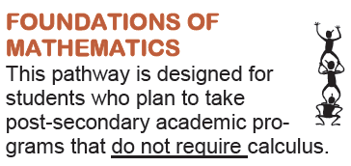
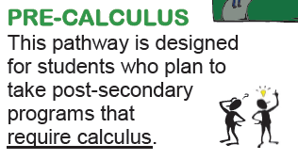
Math pathways

Slide 12
Just a few of SRHS’ Electives
Science
Biology 11/12
Chemistry 11/12
Human Phys 11
Physics 11
Environmental 12
Int to Electronic 11
Robotics 120
Math
Foundations11
Pre Cal 11
Fin & Work 11
Fin & Work 12
Foundations 12
Pre Cal 12A
Pre Cal 12B
Calculus 12
Electives
Entrep 11
Ind Family Dyn 12
Graphic Art/Design 11
Music 11 & 12
PE Leadership 12
Reading Tutor 12
Theatre Arts 12
Visual Art 11 & 12
Wellness 11
Law 120
PIF 11 & 12
Writing 11
Agri Science 120
Auto Expl 12
Bus Org & Man 12
Child Stud 12
Comp Sci 11 & 12
Cul Tech 11 & 12
Early Child Serv 11
Elect Wir 11
Fram & Sheath 11
Human Serv 11
Info Tech 12
Metal Fab 11/12
Nutrition for Healthy
Living 12
Power Train 11
Tech Support 11
Res Finish 120

Slide 13
fIT Focus on Information Technology (FIT) Program is a Canada wide Certificate from the Information and Communications Technology Council (ICTC). FIT provides students with the opportunity to develop technology and business/entrepreneurial skills with essential workplace skills and experience.
Required Courses:
Information Technology 120
Business Organization & Management 120
Plus one of the following:
Entrepreneurship 110
Computer Science 110
Cyber security & Technical support 110
Digital Productions 120

Slide 14
Post graduation
The Six Destinations:
Apprenticeship
University
Community College
Direct to Work
Private Training
Military
* Career Exploration with myBlueprint.ca

Slide 15
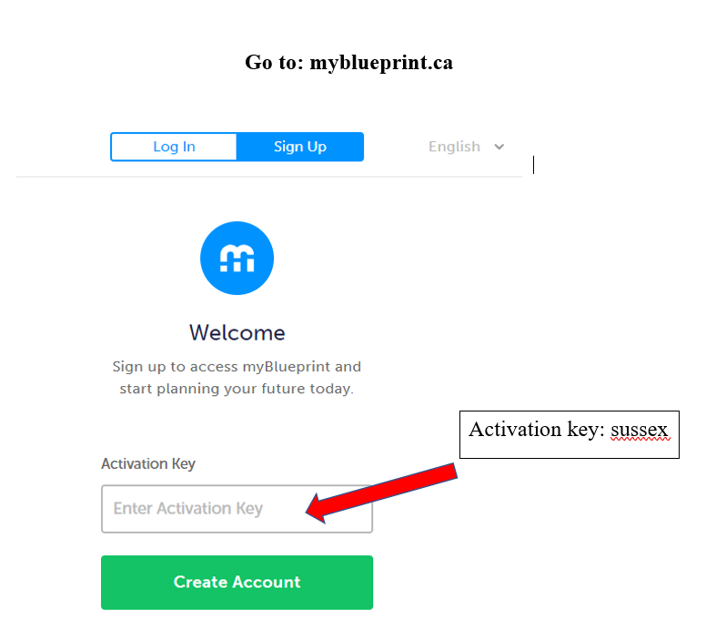
myBlueprint.ca

Slide 16
Selecting your courses
Check Graduation requirements
Check Post-Secondary requirements
Consult: teachers, guidance & parents
Consult the Course Selection Handbook online
Choose a full course load + 2 alternates
Applications for Co-Op & Outdoor Pursuits

Slide 17
PowerSchool
IMPORTANT
Students MUST ensure their log-in usernames and passwords are working prior to inputting their course selections with PowerSchool.
Grade Level Course Selection Form must be signed by a parent/guardian & returned to your G3 Teacher in order to enter your courses.

